Slide 1

Application Layer Part 6
Mark Allman
Case / ICSI
EECS 325/425
Fall 2018
“Now don’t you call James Bond or Secret Agent Man, ‘Cause they can’t do it Like I Can …”

Slide 2
Many of these slides are more-or-less directly from the slide set developed by Jim Kurose and Keith Ross for their book “Computer Networking: A Top Down Approach, 5th edition”.
The slides have been lightly adapted for Mark Allman’s EECS 325/425 Computer Networks class at Case Western Reserve University.
All material copyright 1996-2010
J.F Kurose and K.W. Ross, All Rights Reserved
Allman
2

Slide 3
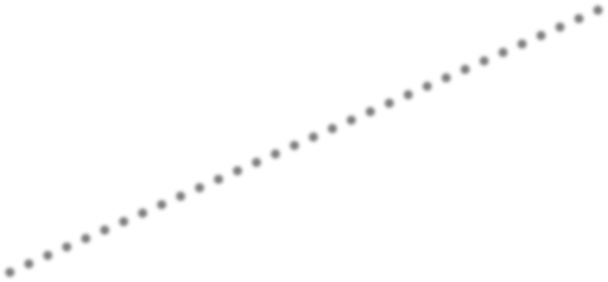

Server-client vs. P2P: example
5.00
P2P
Client-Server
Minimum Distribution Time
3.75
2.50
1.25
0.00
0
5
10
15
20
25
30
35
N

Slide 4
File distribution: BitTorrent
P2P file distribution
Application 2-81

Slide 5
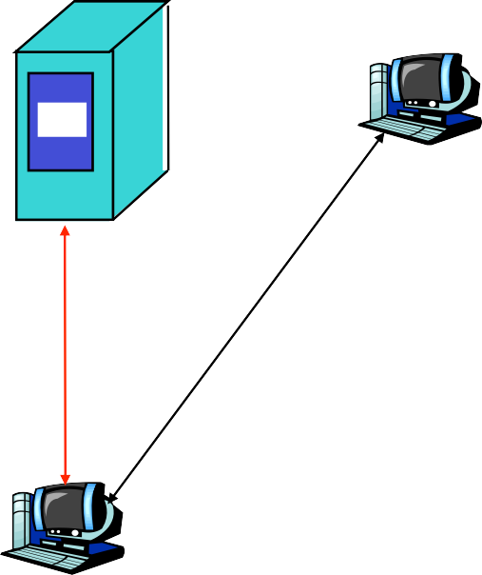








File distribution: BitTorrent
P2P file distribution
tracker: tracks peers participating in torrent
torrent: group of peers exchanging chunks of a file
obtain list of peers
trading chunks
peer
Application 2-81

Slide 6
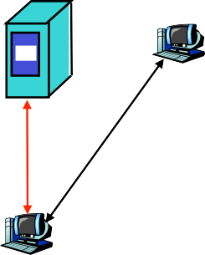









BitTorrent (1)
Application 2-82

Slide 7
BitTorrent (1)
 file divided into 256KB chunks.
Application 2-82

Slide 8
BitTorrent (1)
file divided into 256KB chunks.
peer joining torrent:
has no chunks, but will accumulate them over time
registers with tracker to get list of peers, connects to subset of peers (“neighbors”)
Application 2-82

Slide 9
BitTorrent (1)
file divided into 256KB chunks.
peer joining torrent:
has no chunks, but will accumulate them over time
registers with tracker to get list of peers, connects to subset of peers (“neighbors”)
while downloading, peer uploads chunks to other peers.
Application 2-82

Slide 10
BitTorrent (1)
file divided into 256KB chunks.
peer joining torrent:
has no chunks, but will accumulate them over time
registers with tracker to get list of peers, connects to subset of peers (“neighbors”)
while downloading, peer uploads chunks to other peers.
peers may come and go
Application 2-82

Slide 11
BitTorrent (1)
file divided into 256KB chunks.
peer joining torrent:
has no chunks, but will accumulate them over time
registers with tracker to get list of peers, connects to subset of peers (“neighbors”)
while downloading, peer uploads chunks to other peers.
peers may come and go
once peer has entire file, … ?
Application 2-82

Slide 12
BitTorrent (1)
file divided into 256KB chunks.
peer joining torrent:
has no chunks, but will accumulate them over time
registers with tracker to get list of peers, connects to subset of peers (“neighbors”)
while downloading, peer uploads chunks to other peers.
peers may come and go
once peer has entire file, it may (selfishly) leave or (altruistically) remain
Application 2-82

Slide 13
BitTorrent (2)
Application 2-83

Slide 14
BitTorrent (2)
Pulling Chunks
Application 2-83

Slide 15
BitTorrent (2)
Pulling Chunks
 at any given time, different peers have different subsets of file chunks
Application 2-83

Slide 16
BitTorrent (2)
Pulling Chunks
at any given time, different peers have different subsets of file chunks
periodically, a peer (Alice) asks each neighbor for list of chunks that they have.
Application 2-83

Slide 17
BitTorrent (2)
Pulling Chunks
at any given time, different peers have different subsets of file chunks
periodically, a peer (Alice) asks each neighbor for list of chunks that they have.
Alice sends requests for her missing chunks
 rarest first
Application 2-83

Slide 18
BitTorrent (2)
Pulling Chunks
at any given time, different peers have different subsets of file chunks
periodically, a peer (Alice) asks each neighbor for list of chunks that they have.
Alice sends requests for her missing chunks
 rarest first
Sending Chunks: tit-for-tat
Application 2-83

Slide 19
BitTorrent (2)
Pulling Chunks
at any given time, different peers have different subsets of file chunks
periodically, a peer (Alice) asks each neighbor for list of chunks that they have.
Alice sends requests for her missing chunks
 rarest first
Sending Chunks: tit-for-tat
 Alice sends chunks to four neighbors currently sending her chunks at the highest rate
 re-evaluate top 4 every 10 secs
Application 2-83

Slide 20
BitTorrent (2)
Pulling Chunks
at any given time, different peers have different subsets of file chunks
periodically, a peer (Alice) asks each neighbor for list of chunks that they have.
Alice sends requests for her missing chunks
 rarest first
Sending Chunks: tit-for-tat
Alice sends chunks to four neighbors currently sending her chunks at the highest rate
re-evaluate top 4 every 10 secs
every 30 secs: randomly select another peer, starts sending chunks
newly chosen peer may join top 4
“optimistically unchoke”
Application 2-83

Slide 21
BitTorrent (3)
rough sketch
why 30sec? why 256KB? why 4 neighbors?
8

Slide 22
Distributed Hash Table (DHT)
Application 2-85

Slide 23
Distributed Hash Table (DHT)
DHT: distributed (via P2P) data structure
Application 2-85

Slide 24
Distributed Hash Table (DHT)
DHT: distributed (via P2P) data structure
data structure has (key, value) pairs;
 key: ss number; value: human name
Application 2-85

Slide 25
Distributed Hash Table (DHT)
DHT: distributed (via P2P) data structure
data structure has (key, value) pairs;
key: ss number; value: human name
peers query data structure with key
value that match the key is returned
Application 2-85

Slide 26
Distributed Hash Table (DHT)
DHT: distributed (via P2P) data structure
data structure has (key, value) pairs;
key: ss number; value: human name
peers query data structure with key
value that match the key is returned
peers can also insert (key, value) peers
Application 2-85

Slide 27
DHT Identifiers
Application 2-86

Slide 28
DHT Identifiers
assign integer identifier to each peer in range [0,2^{n}-1].
 Each identifier can be represented by n bits.
Application 2-86

Slide 29
DHT Identifiers
assign integer identifier to each peer in range [0,2^{n}-1].
 Each identifier can be represented by n bits.
require each key to be an integer in same range.
Application 2-86

Slide 30
DHT Identifiers
assign integer identifier to each peer in range [0,2^{n}-1].
Each identifier can be represented by n bits.
require each key to be an integer in same range.
to get integer keys, hash original key.
e.g., key = h(“Led Zeppelin IV”)
this is why they call it a distributed “hash” table
Application 2-86

Slide 31
How to assign keys to peers?
Application 2-87

Slide 32
How to assign keys to peers?
central issue:
 assigning (key, value) pairs to peers.
Application 2-87

Slide 33
How to assign keys to peers?
central issue:
 assigning (key, value) pairs to peers.
rule: assign key to the peer that has the closest ID.
Application 2-87

Slide 34
How to assign keys to peers?
central issue:
 assigning (key, value) pairs to peers.
rule: assign key to the peer that has the closest ID.
convention in lecture: closest is the immediate successor of the key.
Application 2-87

Slide 35
How to assign keys to peers?
central issue:
 assigning (key, value) pairs to peers.
rule: assign key to the peer that has the closest ID.
convention in lecture: closest is the immediate successor of the key.
e.g.,: n=4; peers: 1,3,4,5,8,10,12,14;
key = 13, then successor peer = 14
key = 15, then successor peer = 1
Application 2-87

Slide 36




Circular DHT (1)
1
3
15
4
12
5
10
8
each peer only aware of immediate successor and predecessor.
“overlay network”
Application 2-88

Slide 37


Circular DHT (2)
0001
0011
1111
0100
1100
0101
Define closest as closest
1010
1000
successor
Application 2-89

Slide 38


Circular DHT (2)
x = h(“Led Zepplin IV”) x=1110
Who’s resp. for 1110?
0001
0011
1111
0100
1100
0101
Define closest as closest
1010
1000
successor
Application 2-89

Slide 39
Circular DHT (2)
x = h(“Led Zepplin IV”) x=1110
Who’s resp. for 1110?
0001
0011
1111
1110?
0100
1100
0101
Define closest as closest
1010
1000
successor
Application 2-89

Slide 40
Circular DHT (2)
x = h(“Led Zepplin IV”) x=1110
Who’s resp. for 1110?
0001
0011
1111
1110?
0100
1100
1110?
0101
Define closest as closest
1010
1000
successor
Application 2-89

Slide 41
Circular DHT (2)
x = h(“Led Zepplin IV”) x=1110
Who’s resp. for 1110?
0001
0011
1111
1110?
0100
1100
1110?
1110?
0101
Define closest as closest
1010
1000
successor
Application 2-89

Slide 42
Circular DHT (2)
x = h(“Led Zepplin IV”) x=1110
Who’s resp. for 1110?
0001
0011
1111
1110?
0100
1100
1110?
1110?
0101
Define closest as closest
1110?
1010
1000
successor
Application 2-89

Slide 43
Circular DHT (2)
x = h(“Led Zepplin IV”) x=1110
Who’s resp. for 1110?
0001
0011
1111
1110?
0100
1100
1110?
1110?
0101
1110?
Define closest as closest
1110?
1010
1000
successor
Application 2-89

Slide 44
Circular DHT (2)
x = h(“Led Zepplin IV”) x=1110
Who’s resp. for 1110?
0001
0011
1111
1110?
1110?
0100
1100
1110?
1110?
0101
1110?
Define closest as closest
1110?
1010
1000
successor
Application 2-89

Slide 45
Circular DHT (2)
x = h(“Led Zepplin IV”) x=1110
Who’s resp. for 1110?
0001
I am
0011
1111
1110?
1110?
0100
1100
1110?
1110?
0101
1110?
Define closest as closest
1110?
1010
1000
successor
Application 2-89

Slide 46
Circular DHT (2)
x = h(“Led Zepplin IV”) x=1110
Who’s resp. for 1110?
O(N) messages
0001
on avg to resolve query, when there are N peers
I am
0011
1111
1110?
1110?
0100
1100
1110?
1110?
0101
1110?
Define closest as closest
1110?
1010
1000
successor
Application 2-89

Slide 47
Circular DHT with Shortcuts
1
3
15
4
12
5
10
8
Application 2-90

Slide 48
Circular DHT with Shortcuts
1
3
15
4
12
5
10
8
 each peer keeps track of IP addresses of predecessor, successor, short cuts.
Application 2-90

Slide 49
Circular DHT with Shortcuts
1
Who’s resp for key 1110?
3
15
4
12
5
10
8
 each peer keeps track of IP addresses of predecessor, successor, short cuts.
Application 2-90

Slide 50
Circular DHT with Shortcuts
1
Who’s resp for key 1110?
3
15
4
12
5
10
8
 each peer keeps track of IP addresses of predecessor, successor, short cuts.
Application 2-90

Slide 51
Circular DHT with Shortcuts
1
Who’s resp for key 1110?
3
15
4
12
5
10
8
 each peer keeps track of IP addresses of predecessor, successor, short cuts.
Application 2-90

Slide 52
Circular DHT with Shortcuts
1
Who’s resp for key 1110?
3
15
4
12
5
10
8
each peer keeps track of IP addresses of predecessor, successor, short cuts.
reduced from 6 to 2 messages.
Application 2-90

Slide 53
Circular DHT with Shortcuts
1
Who’s resp for key 1110?
3
15
4
12
5
10
8
each peer keeps track of IP addresses of predecessor, successor, short cuts.
reduced from 6 to 2 messages.
possible to design shortcuts so O(log N) neighbors, O(log N) messages in query
Application 2-90

Slide 54



Peer Churn
1
To handle peer churn, require each peer to know the IP address of its two successors.
Each peer periodically pings its two successors to see if they are still alive.
3
15
4
12
5
10
8
Application 2-91

Slide 55
Peer Churn
1
15
12
To handle peer churn, require each peer to know the IP address of its two successors.
Each peer periodically pings its two successors to see if they are still alive.
3
4
5
10
8
peer 5 abruptly leaves
Application 2-91

Slide 56
Peer Churn
1
To handle peer churn, require each peer to know the IP address of its two successors.
Each peer periodically pings its two successors to see if they are still alive.
3
15
4
12
5
10
8
peer 5 abruptly leaves
Peer 4 detects; makes 8 its immediate successor; asks 8 who its immediate successor is; makes 8’s immediate successor its second successor.
Application 2-91

Slide 57
Distributed Data Structures
16

Slide 58
Distributed Data Structures
DHTs are broadly applicable to many applications
16

Slide 59
Distributed Data Structures
DHTs are broadly applicable to many applications
What is another distributed data structure?
16

Slide 60
Distributed Data Structures
DHTs are broadly applicable to many applications
What is another distributed data structure?
blockchain
essentially a cryptographically secure ledger that can be broadly shared with integrity guarantees
16

Slide 61
P2P Case study: Skype
inherently P2P: pairs of users communicate.
proprietary application- layer protocol (inferred via reverse engineering)
hierarchical overlay with SuperNodes (SNs)
index maps usernames to IP addresses; distributed over SNs
Application 2-92

Slide 62





P2P Case study: Skype
inherently P2P: pairs of users communicate.
proprietary application- layer protocol (inferred via reverse engineering)
hierarchical overlay with SuperNodes (SNs)
index maps usernames to IP addresses; distributed over SNs
Skype clients (SC)
Application 2-92

Slide 63

P2P Case study: Skype
inherently P2P: pairs of users communicate.
proprietary application- layer protocol (inferred via reverse engineering)
hierarchical overlay with SuperNodes (SNs)
index maps usernames to IP addresses; distributed over SNs
Skype clients (SC)
Supernode (SN)
Application 2-92

Slide 64








P2P Case study: Skype
inherently P2P: pairs of users communicate.
proprietary application- layer protocol (inferred via reverse engineering)
hierarchical overlay with SuperNodes (SNs)
index maps usernames to IP addresses; distributed over SNs
Skype clients (SC)
Supernode (SN)
Application 2-92

Slide 65
P2P Case study: Skype
inherently P2P: pairs of users communicate.
proprietary application- layer protocol (inferred via reverse engineering)
hierarchical overlay with SuperNodes (SNs)
index maps usernames to IP addresses; distributed over SNs
Skype clients (SC)
Supernode (SN)
Application 2-92

Slide 66
P2P Case study: Skype
inherently P2P: pairs of users communicate.
proprietary application- layer protocol (inferred
Skype clients (SC)
Skype
Supernode (SN)
via reverse engineering) login server
hierarchical overlay with SuperNodes (SNs)
Index maps usernames to IP addresses; distributed over SNs
Application 2-92

Slide 67
P2P Case study: Skype
inherently P2P: pairs of users communicate.
proprietary application- layer protocol (inferred
Skype clients (SC)
Skype
Supernode (SN)
via reverse engineering) login server
hierarchical overlay with SuperNodes (SNs)
Index maps usernames to IP addresses; distributed over SNs
Application 2-92

Slide 68
P2P Case study: Skype
inherently P2P: pairs of users communicate.
proprietary application- layer protocol (inferred
Skype clients (SC)
Skype
Supernode (SN)
via reverse engineering) login server
hierarchical overlay with SuperNodes (SNs)
Index maps usernames to IP addresses; distributed over SNs
Application 2-92

Slide 69
P2P Case study: Skype
inherently P2P: pairs of users communicate.
proprietary application- layer protocol (inferred
Skype clients (SC)
Skype
Supernode (SN)
via reverse engineering) login server
hierarchical overlay with SuperNodes (SNs)
Index maps usernames to IP addresses; distributed over SNs
Application 2-92

Slide 70
P2P Case study: Skype
inherently P2P: pairs of users communicate.
proprietary application- layer protocol (inferred
Skype clients (SC)
Skype
Supernode (SN)
via reverse engineering) login server
hierarchical overlay with SuperNodes (SNs)
Index maps usernames to IP addresses; distributed over SNs
Application 2-92

